Slide 1
6.006 Introduction to Algorithms Spring 2021
Lecture 9
Graphs & BFS
Nir Shavit

Slide 2
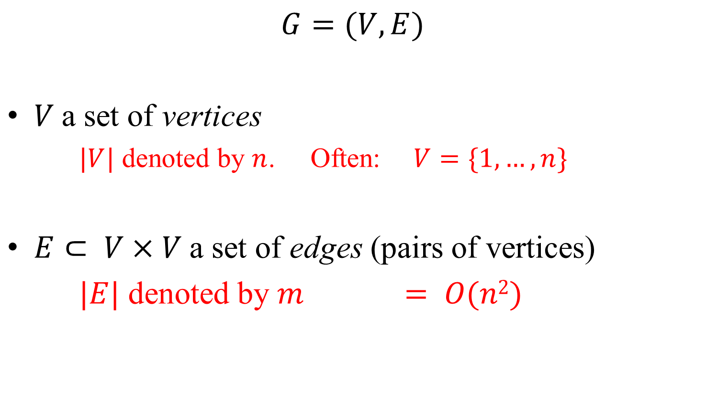
Graphs
$$G=(V,E)$$
$V$a set of vertices
$|V|$ denoted by $n$. Often: $V=\{1,…,n\}$
$E⊂ V×V$a set of edges (pairs of vertices)
$|E|$ denoted by $m = O(n2)$
O(n²)

Slide 3
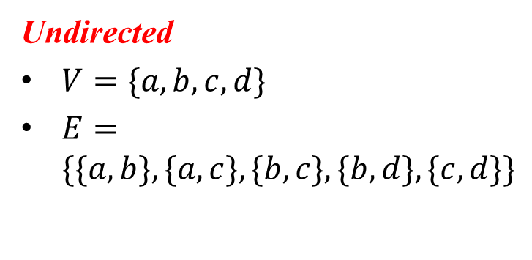
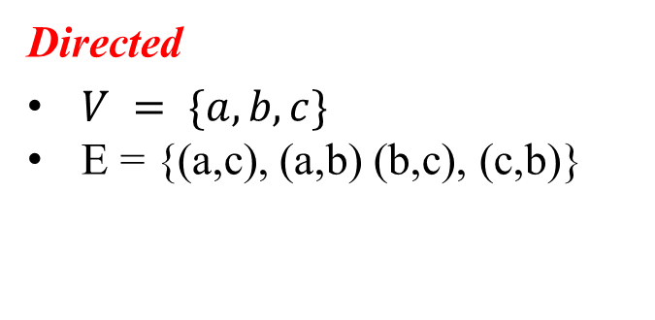
Two Types of Graphs
Undirected
Directed
E = {(a,c), (a,b) (b,c), (c,b)}
a
b
a
c
d
b
c

Slide 4
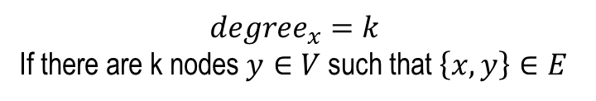

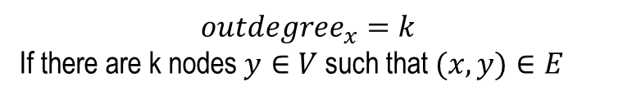
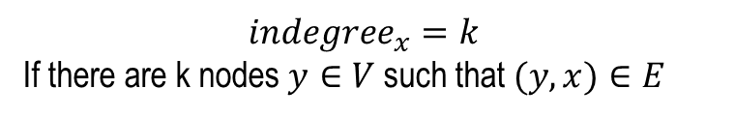
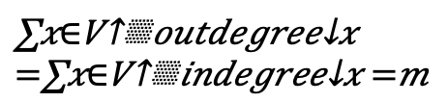
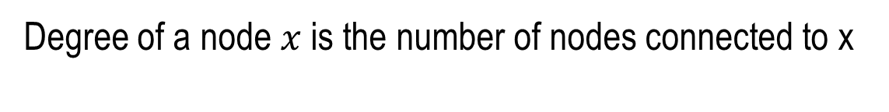
Two Types of Degrees
Degree of a node $x$ is the number of nodes connected to x
$$degree_{x}=k$$
If there are k nodes $y∈V$such that $\left\{x,y\right\}∈E$
$$outdegree_{x}=k$$
If there are k nodes $y∈V$such that$(x,y)∈E$
degree(x) = k
outdegree(x) = k
$$indegree_{x}=k$$
If there are k nodes $y∈V$such that$(y,x)∈E$
indegree(x) = k
Equivalently: $\left\{y,x\right\}∈E$
counted twice
a
b
a
c
d
b
c
degree(a) = 2
degree(b) = 3
outdegree(x)
outdegree(a) = 2
outdegree(b) = 1
indegree(x)
= m
Sum of degrees of all nodes = 2m

Slide 5
Graph Power
Graphs model lots of stuff
Friendship
Powergrids
Maps
Rubik Cube
…
Graphs are visual

Slide 6
Computer Representation 1
(Many, with pros & cons)
Adjacency lists (of neighbors of each vertex)
Directed Graphs:
a
b
c
C
b | /
a
c | /
b
c
b | /

Slide 7
Computer Representation 1
Many representations with pros/cons
Adjacency lists (of neighbors of each vertex)
Incidence lists (of edges from each vertex)
Adjacency matrix (of which pairs are adjacent)
Implicit representation (as neighbor function)
Undirected Graphs:
a
b
c
C
b | /
a
c
a | /
b
c
b
a | /

Slide 8
Computer Representation 2
Many representations with pros/cons
Adjacency matrix
Directed Graphs:
a
b
c
a
a
0
1
1
b
0
0
1
b
c
c
0
1
0

Slide 9
Computer Representation 2
Many representations with pros/cons
Adjacency matrix (of which pairs are adjacent)
Undirected Graphs:
a
b
c
a
a
0
1
1
b
1
0
1
b
c
c
1
1
0

Slide 10
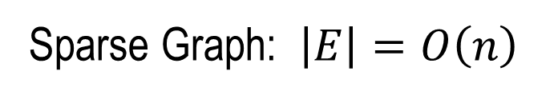
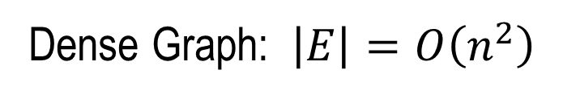
Two Computer Representations
Many representations with pros/cons
Adjacency lists Adjacency matrix
Pros? Cons?
Sparse Graph: $\left|E\right|=O\left(n\right)$
Dense Graph: $\left|E\right|=O\left(n^{2}\right)$
O(n²)
Adjacency List more economical
Adjacency Matrix faster edge check
More popular
Today: Only Undirected Graphs

Slide 11
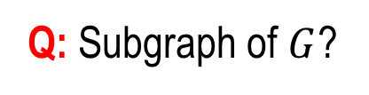




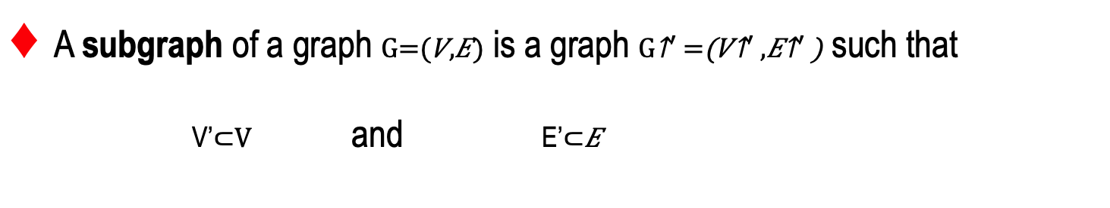
Basic Graph Notions
A subgraph of a graph is a graph such that
V’and E’
A subgraph of a graph G=(V,E) is a graph G’=(V’,E’) such that
a
a
$$∈V$$
$$G$$
d
$$∈E$$
graph
b
c
b
$$∈V$$
Q: Subgraph of $G$?
A: Yes!

Slide 12

Basic Graph Notions
A subgraph of a graph is a graph such that
V’and E’
A subgraph of a graph G=(V,E) is a graph G’=(V’,E’) such that
a
a
$$G$$
d
b
c
c
b
Q: Subgraph of $G$?
A: Yes!

Slide 13

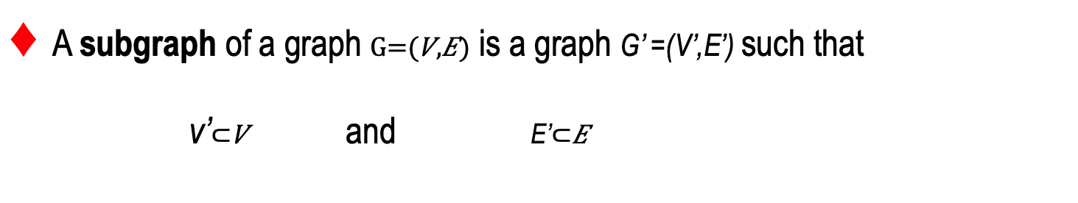
Basic Graph Notions
A subgraph of a graph is a graph G’ =(V’,E’) such that
v’and E’
a
a
$$G$$
d
b
c
b
c
Q: Subgraph of ?
A: Yes!

Slide 14


Basic Graph Notions
A subgraph of a graph is a graph G’ =(V’,E’) such that
v’and E’
a
a
$$G$$
d
b
c
b
Q: Subgraph of $G$?
A: NO!
1.
2.
3.

Slide 15




Basic Graph Notions
A subgraph of a graph is a graph G’ =(V’,E’) such that
v’and E’
A path in is a sequence of vertices such that
$P$ is simple if and only if none of its vertices are equal
a
$$P=a,c,d$$
is simple
$$G$$
d
P’
is not simple
b
c

Slide 16
Basic Graph Notions
A subgraph of a graph is a graph G’ =(V’,E’) such that
v’and E’
A path in is a sequence of vertices such that
$P$ is simple if and only if none of its vertices are equal
is from s₀ to s_{k} is connected to s_{k}
$P$’s length is $k$ (i.e., we count edges)

Slide 17
Basic Graph Notions
A subgraph of a graph is a graph G’ =(V’,E’) such that
v’and E’
A path in is a sequence of vertices such that
$G$is connected if each pair of vertices in $V$ are connected
a
s
d
f
k
z
x
c
v
h
connected
not connected

Slide 18


Basic Graph Notions
A subgraph of a graph is a graph G’ =(V’,E’) such that
v’and E’
A path in is a sequence of vertices such that
$G$is connected if each pair of vertices in $V$ are connected
A connected component of $G$is a maximal connected subgraph of $G$
a
s
d
f
k
?
YES!
YES!
z
x
c
v
h

Slide 19
Basic Graph Notions
A subgraph of a graph is a graph G’ =(V’,E’) such that
v’and E’
A path in is a sequence of vertices such that
$G$is connected if each pair of vertices in $V$ are connected
A connected component of $G$is a maximal connected subgraph of $G$
The distance between $s$ and $t$ is the length of the min-length $s$-to-$t$ path

Slide 20



Basic Graph Problems
Find the distance from s to every other vertex of $G$
Find whether $G$ is connected
Find the connected component to which a vertex $s$ belongs
Find the connected components of $G$
Breadth-First Search

Slide 21

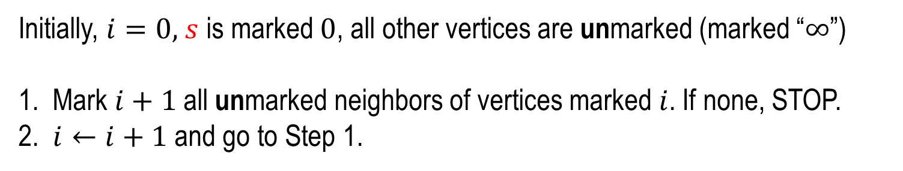
Breadth First Search (From s)
Initially, $i=0,$ $s$ is marked $0$, all other vertices are unmarked (marked “$∞$”)
1. Mark $i+1$all unmarked neighbors of vertices marked $i$. If none, STOP.
2. $i←i+1$and go to Step 1.
Example
1
0
2
a
s
d
$$s$$
f
3
1
z
x
v
c
2
3
2

Slide 22





Breadth First Search (From s)
Initially, $i=0,$ $s$ is marked $0$, all other vertices are unmarked (marked “$∞$”)
1. Mark $i+1$all unmarked neighbors of vertices marked $i$. If none, STOP.
2. $i←i+1$and go to Step 1.
Thm: Upon termination, each vertex is marked with its distance from $s$
Proof Sketch of Thm: By contradiction.
Let $i$ be the minimum such an integer and $t$ a vertex marked $i$ but whose distance from $s$ is $d <i$
the distance of X_{d-1} is .
is marked .
$⇒t$ is marked $d.$
$⇒t$ is marked $<i$

Slide 23






Breadth First Search (From s)
Initially, $i=0,$ $s$ is marked $0$, all other vertices are unmarked (marked “$∞$”)
1. Mark $i+1$all unmarked neighbors of vertices marked $i$. If none, STOP.
2. $i←i+1$and go to Step 1.
BFS finds min distances (from s)
Complexity of BFS?
$$O\left(m\right)?$$
$$i=1,…,O(n)$$
$$O\left(n×m\right)?$$
$$O\left(n\right)?$$
$$i=1,…,O(n)$$
CAREFUL COUNTING
The cornerstone of efficient graph algorithms

Slide 24



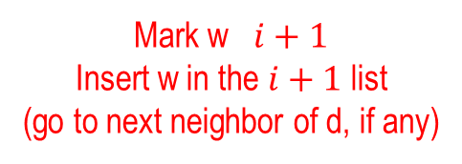









Breadth First Search (From s)
Initially, $i=0,$ $s$ is marked $0$, all other vertices are unmarked (marked “$∞$”)
1. Mark $i+1$all unmarked neighbors of vertices marked $i$. If none, STOP.
2. $i←i+1$and go to Step 1.
“Move & process d”
$$≡$$
d
Marked $i$list
$$i$$
h
f
$$…$$
$$i$$
Marked $i+1$list
$$≡$$
$$+$$
$$1$$
w
f
3
$$∞$$
d
f
w
g
…
7
Etc. etc.
g
$$∞$$
Mark w $i+1$
Insert w in the $i+1$ list
(go to next neighbor of d, if any)
Do Nothing
(go to next neighbor of d)
w
∞
$$i$$
$$+$$
$$1$$
h
48
Adjacency List
Marked Array

Slide 25
Breadth First Search (From s)
Initially, $i=0,$ $s$ is marked $0$, all other vertices are unmarked (marked “$∞$”)
1. Mark $i+1$all unmarked neighbors of vertices marked $i$. If none, STOP.
2. $i←i+1$and go to Step 1.
“Move & process d”
$$≡$$
d
Marked $i$list
$$i$$
h
f
$$…$$
$$i$$
Marked $i+1$list
$$≡$$
$$+$$
$$1$$
w
f
3
$$∞$$
d
f
w
g
…
7
g
$$∞$$
w
$$i$$
$$+$$
$$1$$
h
48
Adjacency List
Marked Array

Slide 26

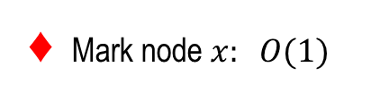
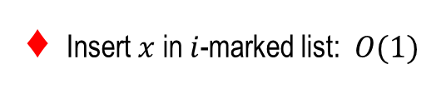

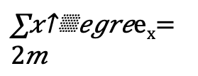
Breadth First Search (From s)
Initially, $i=0,$ $s$ is marked $0$, all other vertices are unmarked (marked “$∞$”)
1. Mark $i+1$all unmarked neighbors of vertices marked $i$. If none, STOP.
2. $i←i+1$and go to Step 1.
“Move & process d”
$$≡$$
d
Marked $i$list
$$i$$
h
f
$$…$$
$$i$$
Marked $i+1$list
$$≡$$
$$+$$
$$1$$
w
f
3
d
$$∞$$
d
f
w
g
…
7
Mark node $x: O(1)$
g
$$∞$$
Insert $x$ in $i$-marked list:$O(1)$
$$BFS: Θ(n+m)$$
w
$$i$$
$$+$$
$$1$$
P
Can we do better?
h
48
Adjacency List
Marked Array

Slide 27
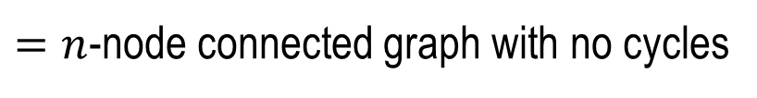

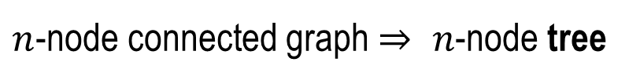
One More Visual Time
Keeping track of the edge through which a node is marked
1
0
2
a
s
d
f
3
1
z
x
v
c
2
3
2
Marked-0 list:
s
Marked-1 list:
a
x
$n$-node connected graph $⇒ n$-node tree
Marked-2 list:
z
c
d
$=n$-node connected graph with no cycles
Marked-3 list:
v
f
$$bcs each node marked only once!$$

Slide 28
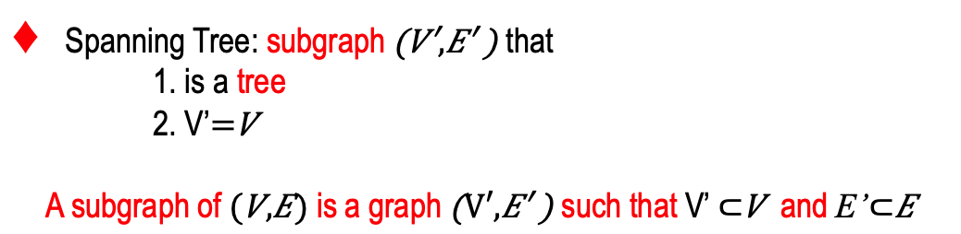
BFS Tree (if G connected)
Spanning Tree: subgraph that
1. is a tree
2. V’
A subgraph of is a graph such that V’ and E’
Extra Structure:
z
?
a
f
Nooooooo!!!!
s
d
?
Possible!
x
?
v
Possible Too
c
BFS Tree: Few Data, Very Informative!

Slide 29

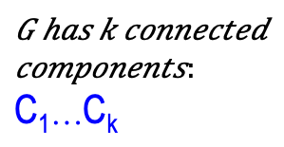

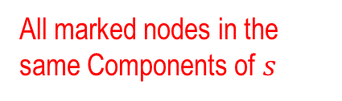

BFS when G not connected
Initially, $i=0,$ $s$ is marked $0$, all other vertices are unmarked (marked “$∞$”)
1. Mark $i+1$all unmarked neighbors of vertices marked $i$. If none, STOP.
2. $i←i+1$and go to Step 1.
n=n₁…n_{k}
C₁…C_{k}
m=m₁…m_{k}
To find all components
1
0
s
2
3
C₁
a
$$s$$
d
f
$$⋯$$
2
z
1
x
c
v
3
2
C_{k}
All marked nodes in the same Components of $s$

Slide 30
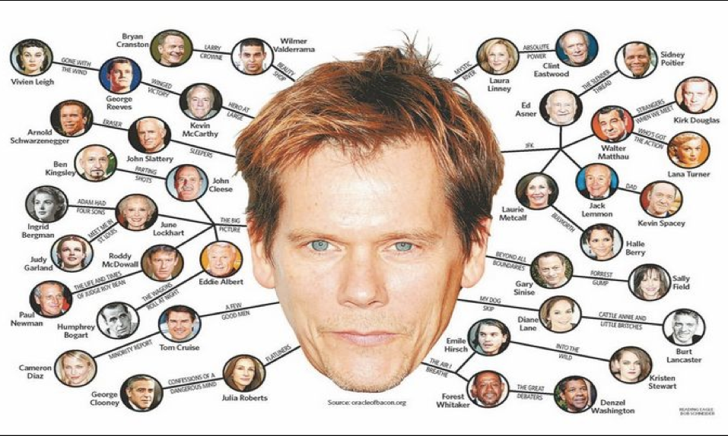
Bacon Number

Slide 31
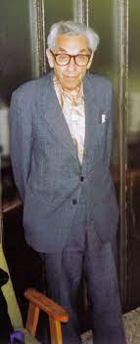
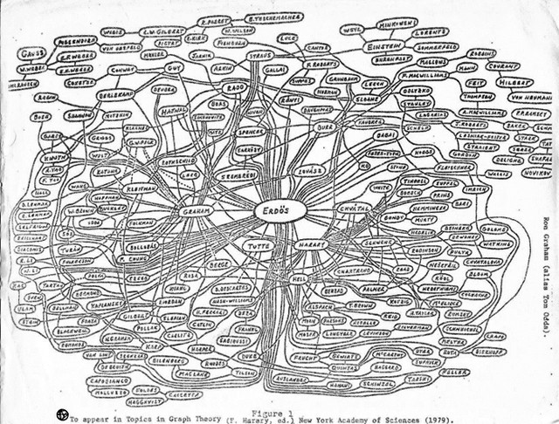
Erdős Number
The Erdős number describes the "collaborative distance" (Shortest path)
between Paul Erdős, the father of combinatorics, and another person, as measured by authorship of mathematical papers.

Slide 32

Natali Portman Erdős–Bacon number of 7
MIT Mathematician Prof. Daniel Kleitman has the lowest, an Erdős–Bacon number of 3. He co-authored papers with Erdős and has a Bacon number of 2 via Minnie Driver in Good Will Hunting.

